Slide 1


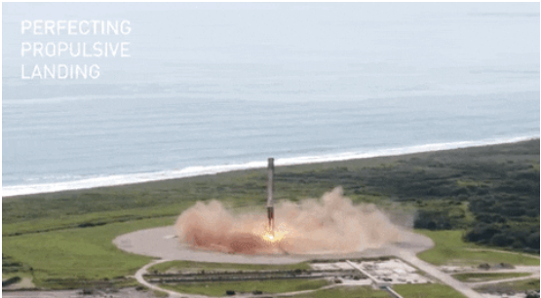
IBM Data Science
Capstone Project
Space X Falcon 9 Landing Analysis
NOMER EVANGELISTA

Slide 2

Outline
Executive Summary
Introduction
Methodology
Results
Conclusion
Appendix
2

Slide 3
Executive Summary
Summary of Methodologies
This project followed these steps:
Data Collection
Data Wrangling
Exploratory Data Analysis
Interactive Visual Analytics
Predictive Analysis (Classification)
Summary of all results
Four machine learning models were created: Logistic Regression, Support Vector Machine, Decision Tree Classifier, and K Nearest Neighbors. These models have produced similar results, with an accuracy rate of around 83.33%. One thing to note is that all the models tend to overestimate the number of successful landings. To improve the accuracy and reliability of the models, it is essential to gather more data for a more thorough analysis.

Slide 4
Introduction
Project background and context
SpaceX has gained recognition for launching Falcon 9 rockets at a relatively low cost of around $62 million, which is significantly cheaper compared to other providers who usually charge upwards of $165 million. The primary reason behind this huge difference in cost is that SpaceX has developed the ability to land and reuse the first stage of the rocket, which helps it save a considerable amount of money.
If we can predict the success of the first stage landing, we can calculate the launch cost. This information can help us evaluate whether SpaceY company should bid against SpaceX for a rocket launch.
Problems you want to find answers
Space Y tasks us to train a machine learning model to predict successful Stage 1 recovery

Slide 5
Methodology
Executive Summary
Data collection methodology:
Data was obtained from SpaceX's public API and Wikipedia page
Perform data wrangling
The data was then processed and categorized into successful and unsuccessful landings
Perform exploratory data analysis (EDA) using visualization and SQL
Perform interactive visual analytics using Folium and Plotly Dash
Perform predictive analysis using classification models
Predictive analysis was conducted using classification models, which were fine-tuned using the GridSearchCV method.

Slide 6
Data Collection
For the data collection process, I used a combination of API requests from Space X's public API and web scraping data from a table on Space X's Wikipedia page. The upcoming slide will display the flowchart of data collection from the API, while the following slide will illustrate the flowchart of data collection from web scraping.
Space X API Data Columns:
FlightNumber, Date, BoosterVersion, PayloadMass, Orbit, LaunchSite, Outcome, Flights, GridFins, Reused, Legs, LandingPad, Block, ReusedCount, Serial, Longitude, Latitude
Wikipedia Webscrape Data Columns:
Flight No., Launch site, Payload, PayloadMass, Orbit, Customer, Launch outcome, Version Booster, Booster landing, Date, Time

Slide 7
Data Collection – SpaceX API
Make GET response to SpaceX REST API
Filter data to only include Falcon 9 launches
Reset the Flight Number column
Data collection process involved a combination of API requests from Space X public API and web scraping data from a table in Space X’s Wikipedia entry.
Space X API Data Columns:
FlightNumber, Date, BoosterVersion, PayloadMass, Orbit, LaunchSite, Outcome, Flights, GridFins, Reused, Legs, LandingPad, Block, ReusedCount, Serial, Longitude, Latitude
Wikipedia Webscrape Data Columns:
Flight No., Launch site, Payload, PayloadMass, Orbit, Customer, Launch outcome, Version Booster, Booster landing, Date, Time
Convert response to .json file then to Pandas DataFrame
Create Pandas DataFrame form the constructed dictionary dataset
Replace missing values of PayloadMass with mean value
Use custom logic to clean the data
Use list values in dictionary and construct dataset

Slide 8
Data Collection - Scraping
Request Wikipedia html from URL
Iterate table cells to extract data to dictionary
Use the column names as keys in dictionary
GitHub URL
Webscraping
Save response to a variable
Collect all column header from the tables within the HTML page
Convert the dictionary to Pandas DataFrame for export
Use BeautifulSoup html5lib Parser
Find all tables within HTML page
Notes:
https://github.com/nomer-evangelista/IBM-Data-Science-Module-10/blob/main/Week%201/Webscraping.ipynb

Slide 9
Data Manipulation (Data Wrangling)
Create a training label with landing outcomes where successful = 1 & failure = 0.
Outcome column has two category: ‘Mission Outcome’ , ‘Landing Location’
New training label column ‘class’ with a value of 1 if ‘Mission Outcome’ is True and 0 otherwise.
Value Mapping:
True ASDS, True RTLS, & True Ocean – set to -> 1
None None, False ASDS, None ASDS, False Ocean, False RTLS – set to -> 0
GitHub URL:
Data Wrangling

Slide 10
Exploratory Data Analysis (EDA) with Visualization
Exploratory Data Analysis was carried out on various variables such as Flight Number, Payload Mass, Launch Site, Orbit, Class, and Year. To determine if any relationships existed between these variables that could be used in the machine learning model, several plots were used.
Flight Number vs. Payload Mass, Flight Number vs. Launch Site, Payload Mass vs. Launch Site,
Orbit vs. Success Rate, Flight Number vs. Orbit, Payload vs Orbit, and Success Yearly Trend.
To examine the relationships between the variables, different types of charts were used, such as scatter plots, line charts, and bar plots.
GitHub URL:
EDA with Visualization

Slide 11
Exploratory Data Analysi (EDA) with SQL
Data set was loaded into from Database into Jupyter.
SQL Python integration was used to run queries.
Queries were made to gain a better understanding of the dataset.
Information was queried about the launch site names, mission outcomes, various payload sizes of customers and booster versions, and landing outcomes.
GitHub URL:
EDA with SQL

Slide 12
Build an Interactive Map with Folium
Folium maps are utilized to indicate the locations of rocket launches, both successful and unsuccessful landings, and their proximity to key features such as railways, highways, coasts, and cities.
This helps us comprehend the reasoning behind the selection of launch sites in specific areas and also enables us to visualize the success rate of landings to their location.
GitHub URL
Interactive Map with Folium

Slide 13
Build a Dashboard with Plotly Dash
The dashboard consists of two visual representations, a pie chart, and a scatter plot.
The pie chart offers the option to view the distribution of successful landings across all launch sites or the success rates of individual launch sites. On the other hand, the scatter plot allows you to select between two inputs; all sites or individual sites, and then set the payload mass on a slider ranging from 0 to 10000 kg.
The pie chart is a great tool to quickly visualize the success rate of each launch site, while the scatter plot can help us identify variations in success rates across launch sites, payload mass, and booster versions.
GitHub URL
Dashboard with Plotly Dash

Slide 14
Predictive Analysis (Classification)
Use GridSearchCV on Logistic Regression, Support Vector Machine, Decision Tree, and KNN models
Barplot to compare scores of models
GitHub URL
Predictive Analysis (Classification)
Split label column ‘Class’ from dataset
Perform necessary data transformations (standard preprocess)
Use GridSearchCV (cv=10) to find optimal parameters
Classification report for all models
Fit and Transform using StandarScaler
Split data into Train, Test data set
Confusion Matrix for all models

Slide 15

Results
Exploratory Data Analysis results
Interactive analytics demo in screenshots
Predictive analysis results

Slide 16
E D A with Visualization
EXPLORATORY DATA ANALYSIS WITH SEABORN PLOTS

Slide 17
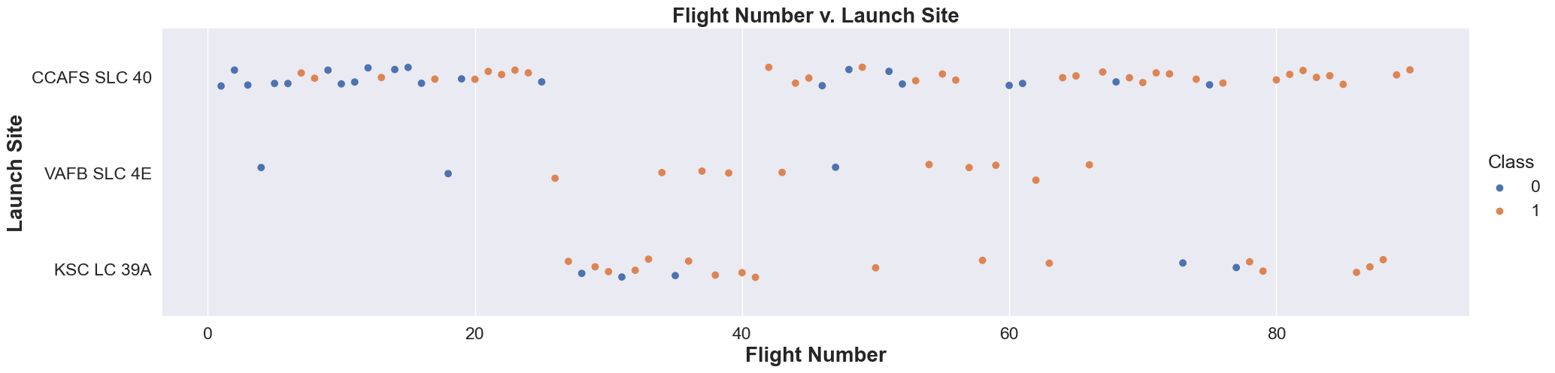
Flight Number vs. Launch Site
Class 0 = Unsuccessful launch and Class 1 = Successful launch
As the number of flights increases, the rate of success at a launch site increases.
Most of the early flights (flight numbers < 30) were launched from CCAFS SLC 40, and were generally successful.
CCAFS appears to be the main launch site as it has the most volume.

Slide 18
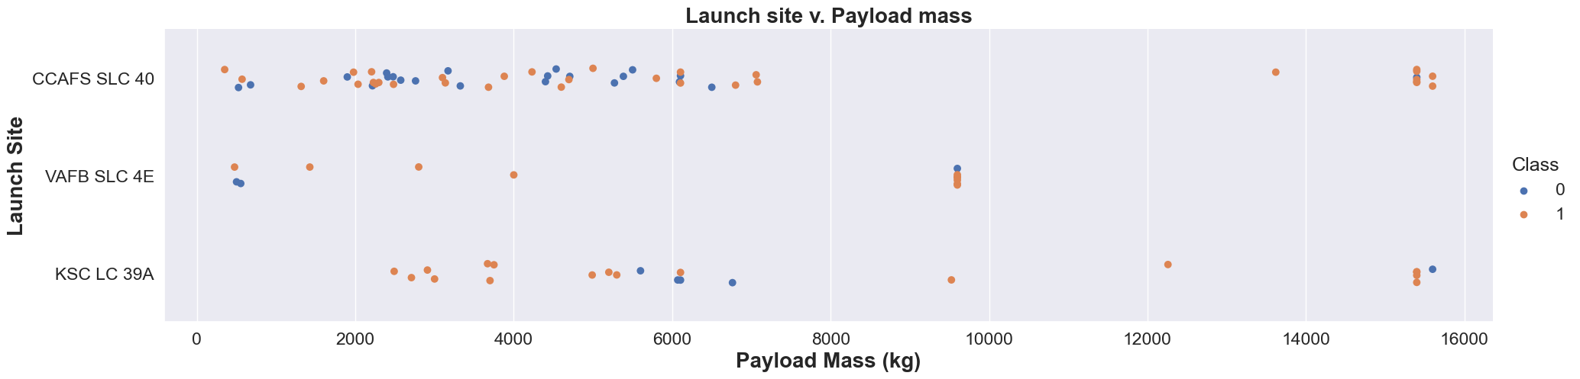
Payload vs. Launch Site
Class 0 = Unsuccessful launch and Class 1 = Successful launch
Above a payload mass of around 7000 kg, there are very few unsuccessful landings, but there is also far less data for these heavier launches.
VAFB-SLC launchsite there are no rockets launched for heavypayload mass (greater than 10,000)

Slide 19
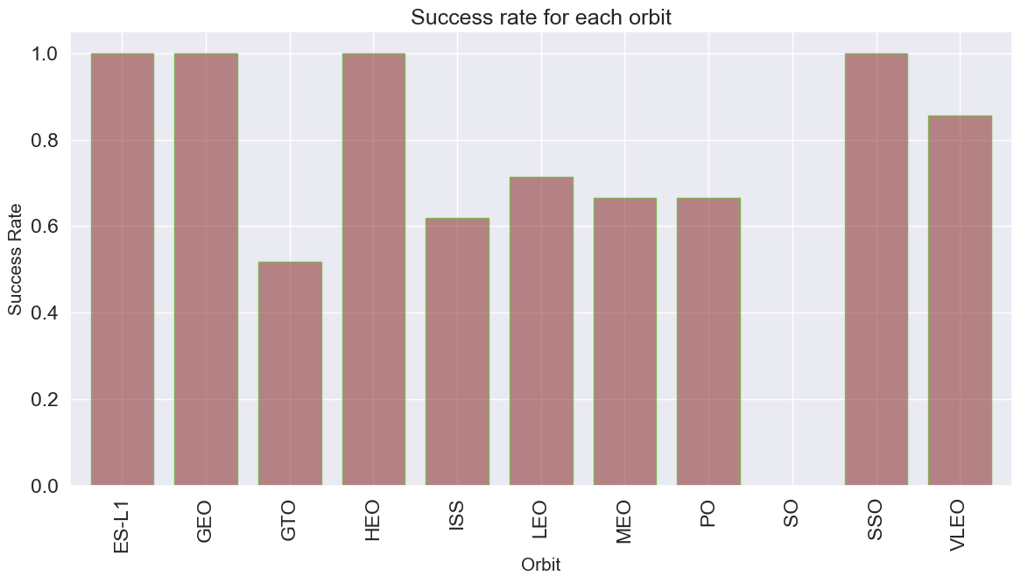
Success Rate vs. Orbit Type
ES-L1, GEO, HEO, SSO has 100% success rate
ISS, LEO, MEO, PO have over 60% success rate
VLEO has decent success rate and attempts
SO has 0% success rate
GTO has the around 50% success rate but largest sample
Success Rate Scale with 0 as 0%
0.6 as 60% 1 as 100%

Slide 20
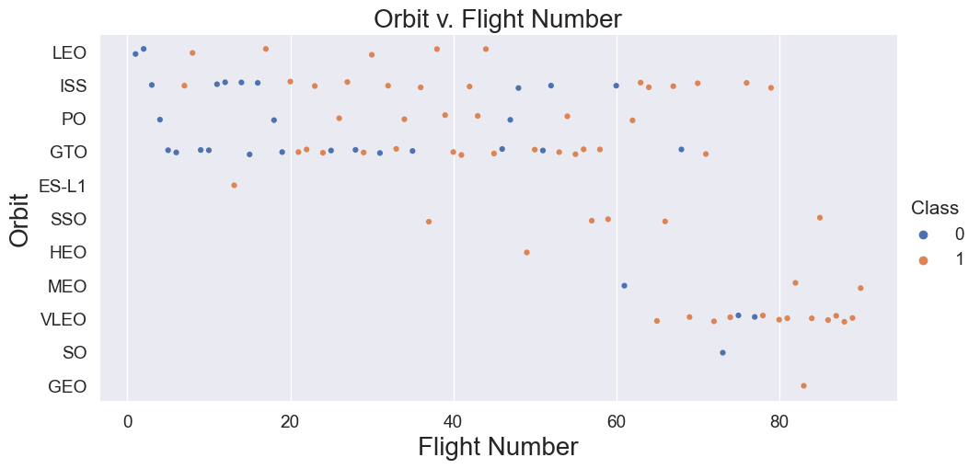
Flight Number vs. Orbit Type
Class 0 = Unsuccessful launch and Class 1 = Successful launch
The 100% success rate of GEO, HEO, and ES-L1 orbits can be explained by only having 1 flight into the respective orbits.
The 100% success rate in SSO is more impressive, with 5 successful flights.
There is little relationship between Flight Number and Success Rate for GTO.

Slide 21
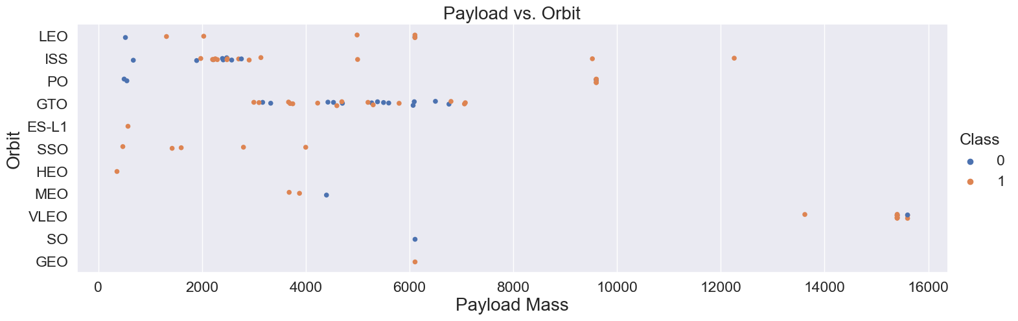
Payload vs. Orbit Type
Class 0 = Unsuccessful launch and Class 1 = Successful launch
LEO and SSO seem to have relatively low payload mass
The other most successful orbit VLEO only has payload mass values in the higher end of the range
For GTO, the relationship between payload mass and success rate is unclear.

Slide 22
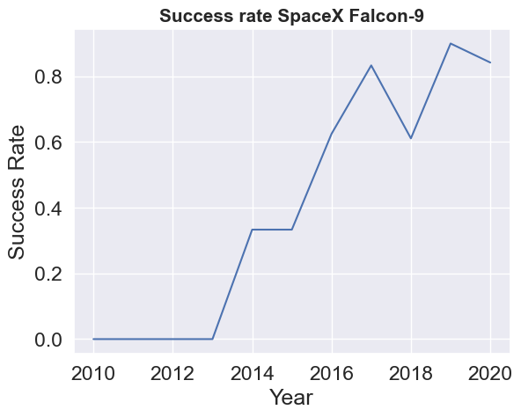
Launch Success Yearly Trend
Success generally increases over time since 2013 with a slight dip in 2018
Success in recent years at around 80%
Between 2010 and 2013, all landings were unsuccessful (as the success rate is 0).
After 2013, the success rate generally increased, despite small dips in 2018 and 2020.

Slide 23
EDA with SQL
________________________________________
EXPLANATORY DATA ANALYSIS
INTEGRATED IN PYTHON WITH SQLALCHEMY

Slide 24
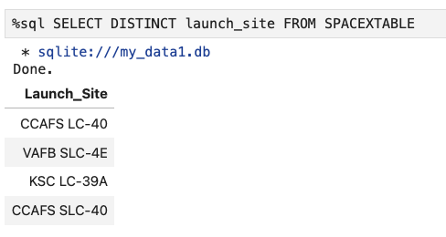
All Launch Site Names
Launch Site
CCAFS LC-40
VAFB SLC-4E
KSC LC-39A
CCAFS SLC-40
Used DISTINCT returns only unique values from the Launch_site column of the SPACEXTBL

Slide 25
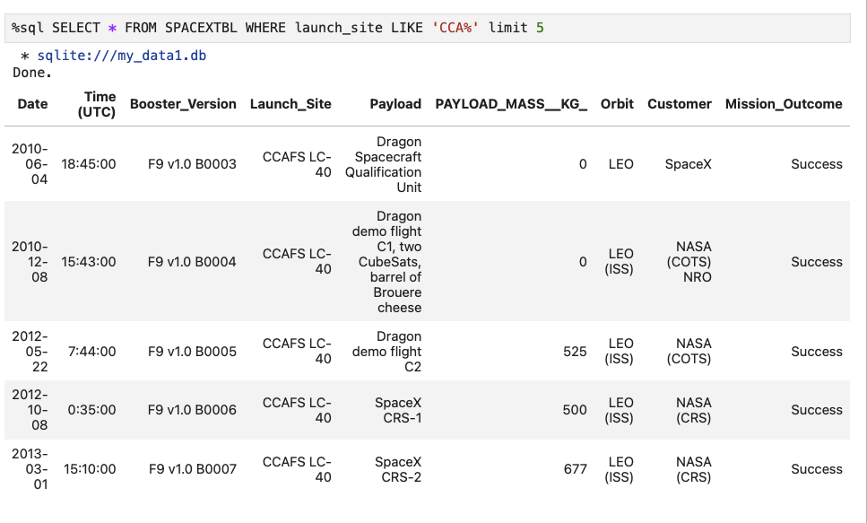
Launch Site Names Begin with 'CCA'
First 5 entries in database with Launch_Site name beginning with CCA.

Slide 26
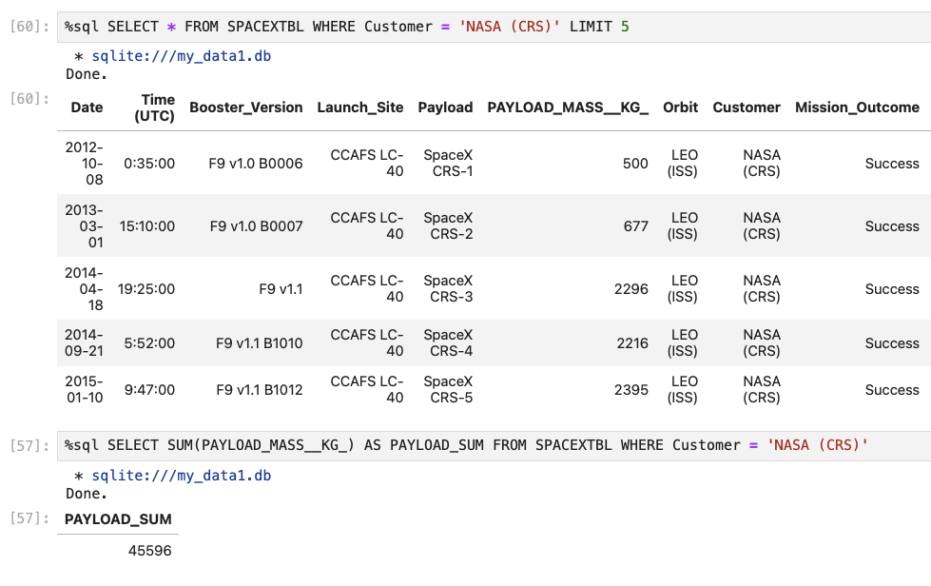
Total Payload Mass
Used SUM to calculate to the total the LAUNCH column, and filter NASA (CRS) was the Customer

Slide 27
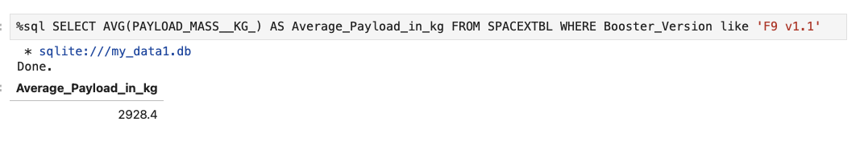
Average Payload Mass by F9 v1.1
Use the SUM to calculate the total LAUNCH column filter where NASA (CRS) was Booster_Version equals to ‘F9 v1.1’

Slide 28
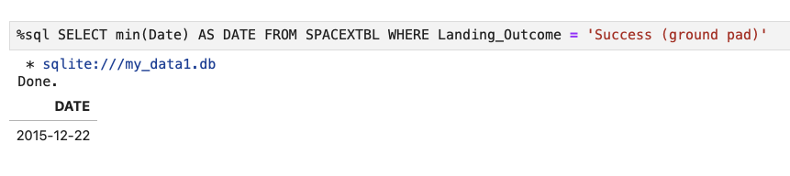
First Successful Ground Landing Date
Use MIN to calculate the minimum Date column where Landing_Outcome was ‘Success (ground pad)’

Slide 29
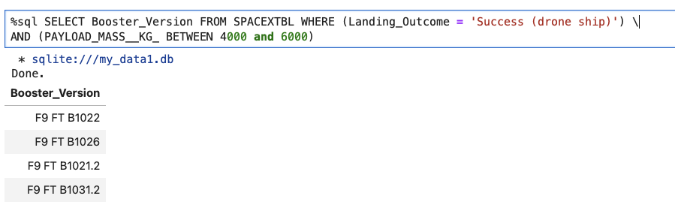
Successful Drone Ship Landing with Payload between 4000 and 6000
Use WHERE to filter Landing_Outcome are ‘Success (drone ship)’ and Payload Mass is between 4000 and 6000

Slide 30
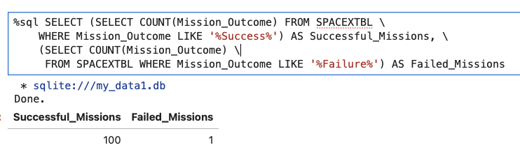
Total Number of Successful and Failure Mission Outcomes
Use the COUNT to calculate Mission_Outcome WHERE Mission_Outcome are ‘Successful’ and ‘Failed’ missions

Slide 31
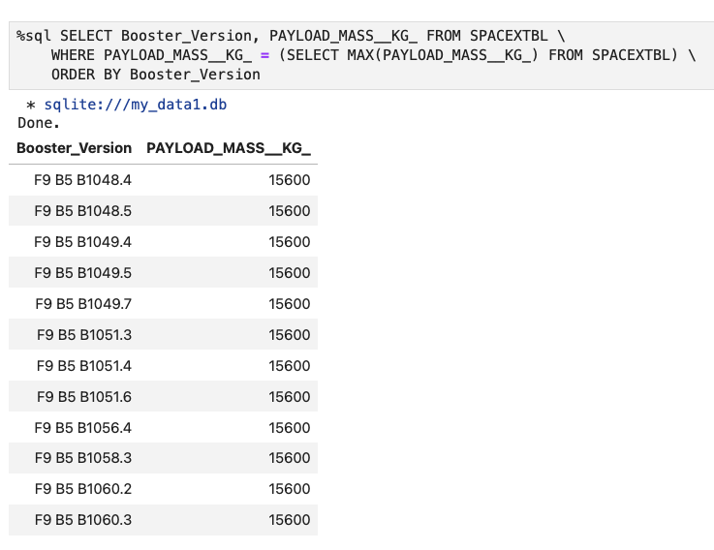
Boosters Carried Maximum Payload
Used a subquery to look for the MAX of Payload_Mass then apply it to WHERE to find the Booster_Version with the max Payload

Slide 32
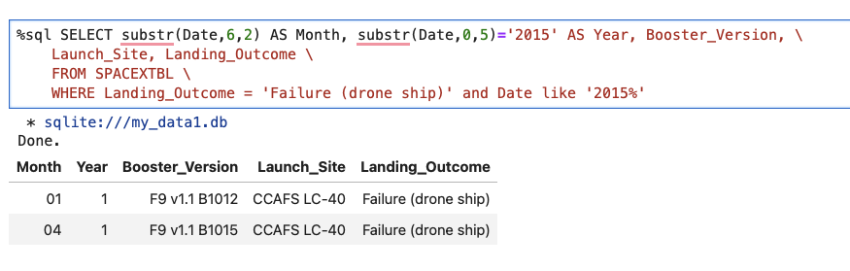
2015 Launch Records
List all failed Landing_Outcome, WHERE Landing_Outcone is ‘Failure (drone ship)’ and Date is year in ‘2015’

Slide 33
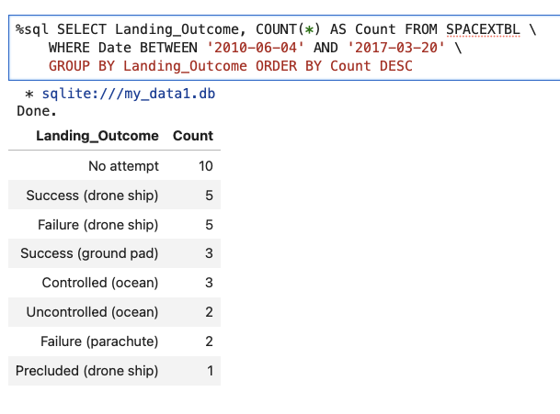
Rank Landing Outcomes Between 2010-06-04 and 2017-03-20
Rank the COUNT on Landing_Outcome WHERE between ‘2010-06-04’ and ‘2017-03-20’. Grouping by Landing_Outcome and arrange COUNT by descending

Slide 34
INTERACTIVE MAP WITH FOLIUM ______________________

Slide 35
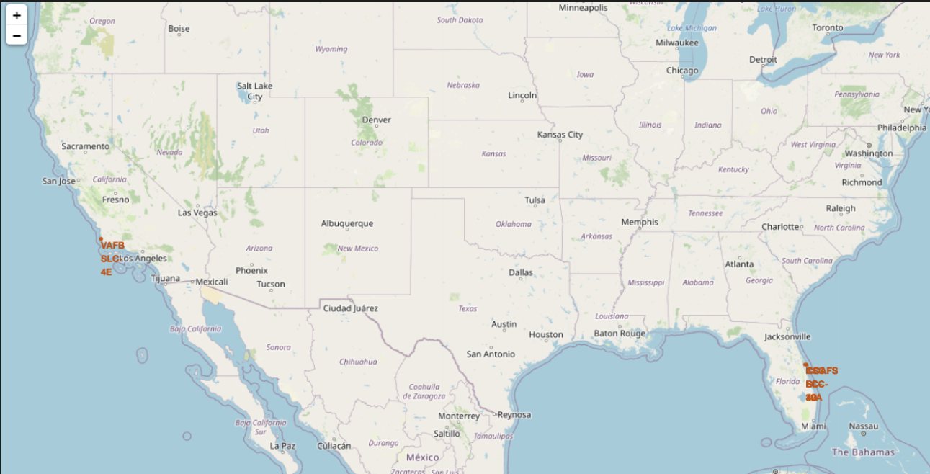
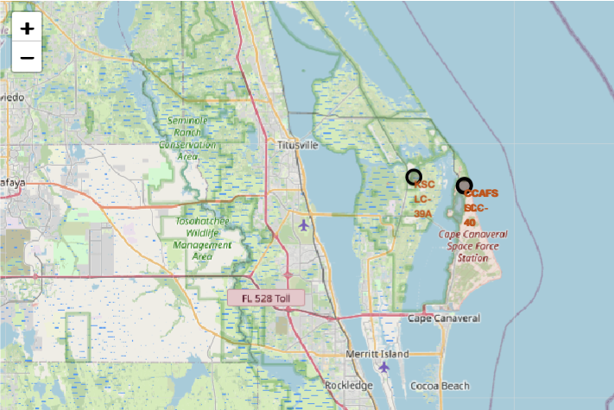
ALL LAUNCH SITES ON A MAP
The left map shows all launch sites relative US map.
The right map shows the two Florida launch sites since they are very close to each other.
All launch sites are near the ocean.

Slide 36
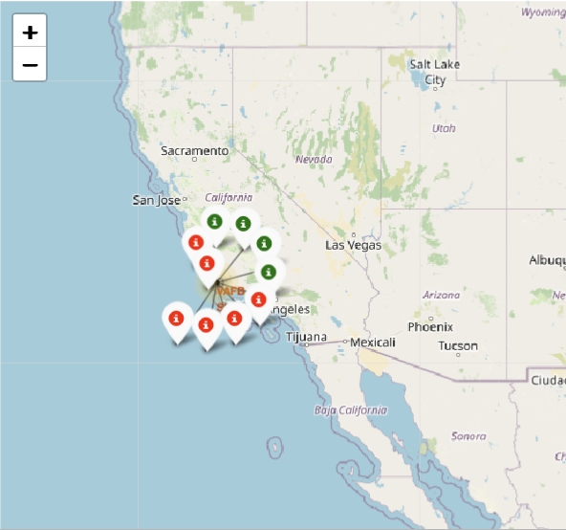
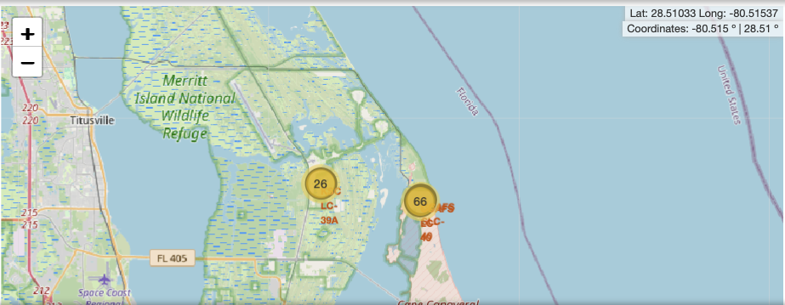
Color-Coded Launch Markers
Clusters on Folium map can be clicked on to display each successful landing (green icon) and failed landing (red icon).

Slide 37
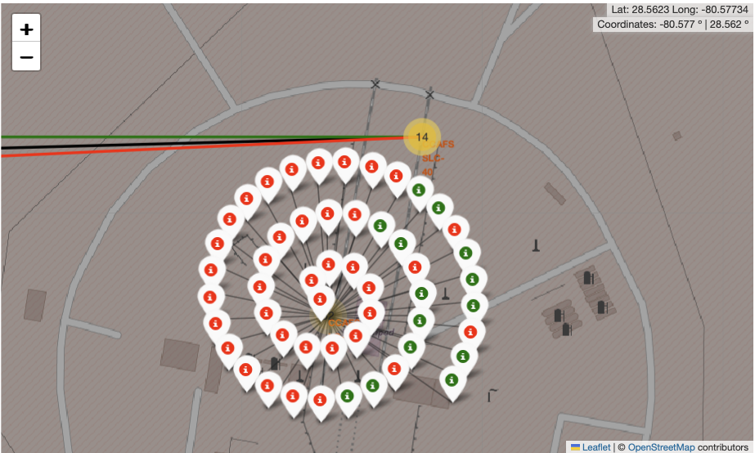
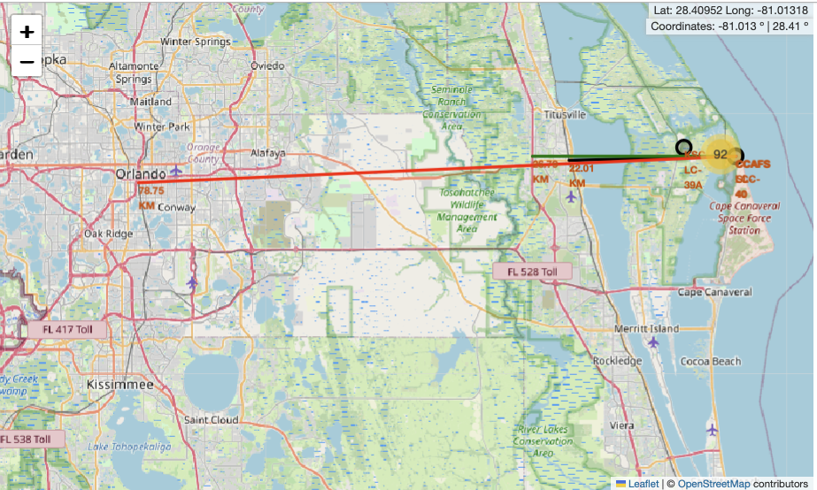
Location Promities
Launch sites are strategically located near highways to facilitate the transportation of both humans and supplies. They are also situated near coasts and at a considerable distance from cities, to ensure that any launch failures can be safely directed towards the sea, thus avoiding densely populated areas.

Slide 38

Interactive Dashboard with
- Plotly Dash

Slide 39
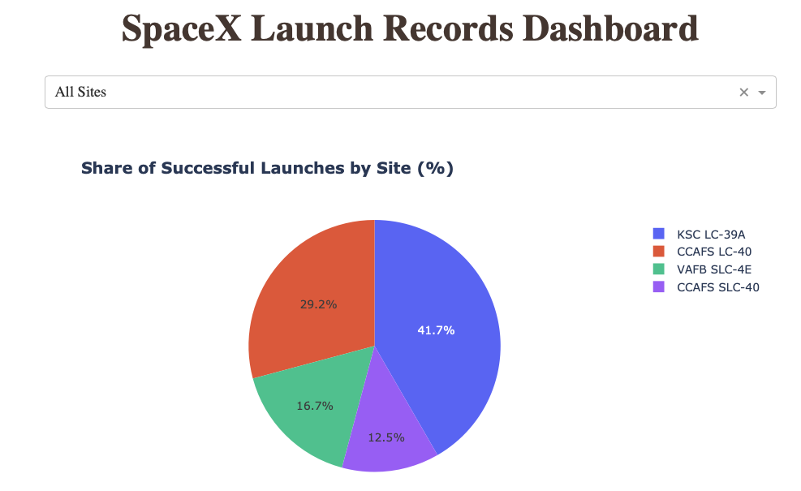
Sucessful Launches Across All Site
This is the distribution of successful landings across all launch sites.
The launch site KSC LC-39 A had the most successful launches, with 41.7% of the total successful launches

Slide 40
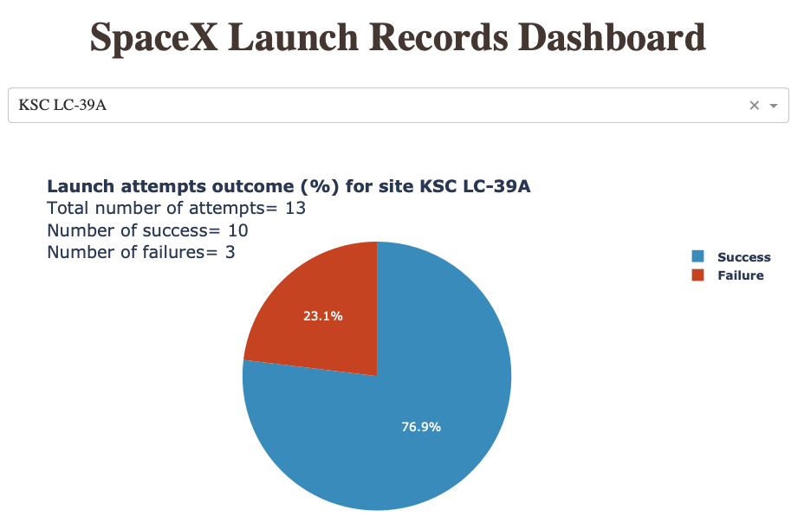
Highest Success Rate Launch Site
KSC LC-39A has the highest success rate with 10 successful landings and 3 failed landings. Successful launches, with a 76.9% success rate.

Slide 41
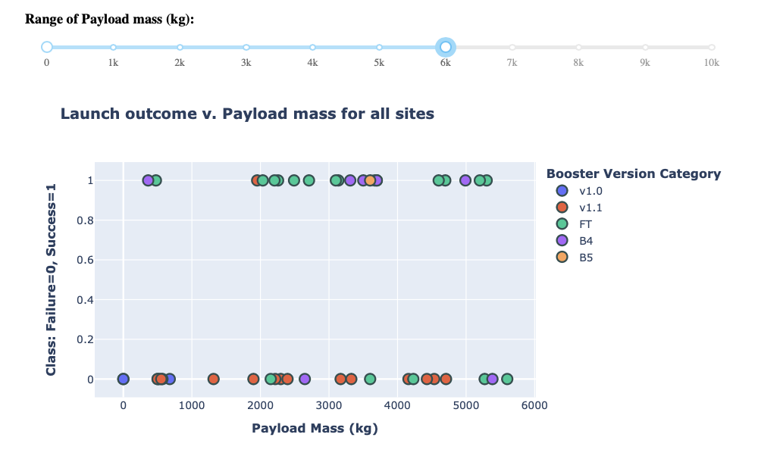
Payload Mass vs. Success vs. Booster Version Category
Plotly dashboard has a Payload range selector. However, this is set from 0-10000 instead of the max Payload of 15600. Class indicates 1 for successful landing and 0 for failure. Scatter plot also accounts for booster version category in color and number of launches in point size. In this particular range of 0-6000, interestingly there are two failed landings with payloads of zero kg.

Slide 42
PREDICTIVE ANALYSIS –
CLASSIFICATION

Slide 43
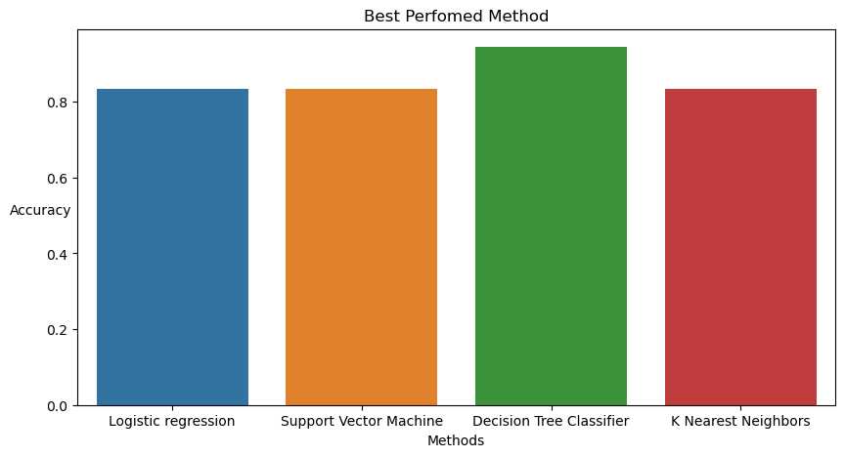
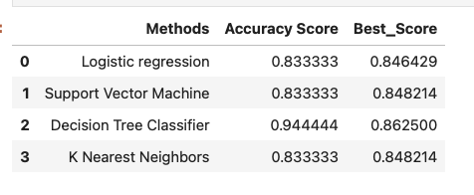
Classification Accuracy

Slide 44
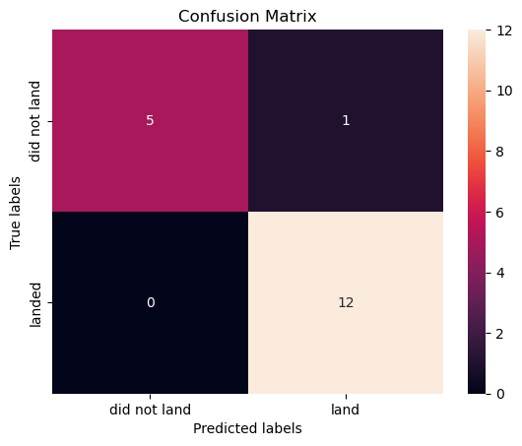
Confusion Matrix
Decision Tree was the best model, with an accuracy of 94.44%.
All models performed the same for the test set, the confusion matrix is similar across all models. Majority of the models predicted 12 successful landings when the true label was successful landing.
The other 17 results are correctly classified (5 did not land, 12 did land).

Slide 45
Conclusions
Our task: to develop a machine learning model for Space Y who wants to bid against SpaceX
The goal of model is to predict when Stage 1 will successfully land to save ~$100 million USD
Used data from a public SpaceX API and web scraping SpaceX Wikipedia page
Created data labels and stored data into a DB2 SQL database
Created a dashboard for visualization
We created a machine learning model with an accuracy of 83%
The success for massive payloads (over 4000kg) is lower than that for low payloads.
The best performing classification model is the Decision Tree model, with an accuracy of 94.44%.

Slide 46
Appendix
GitHub repository URL
IBM Data Science Capstone Project
Special Thanks to All Instructors:
Rav Ahuja, Alex Aklson, Aije Egwaikhide, Svetlana Levitan, Romeo Kienzler, Polong Lin, Joseph Santarcangelo, Azim Hirjani, Hima Vasudevan, Saishruthi Swaminathan, Saeed Aghabozorgi, Yan Luo

